Slide 1


Azərbaycan Dövlət Neft və Sənaye Universiteti
Calculus
Single Variable

Slide 2
Applications of Differentiation

Slide 3
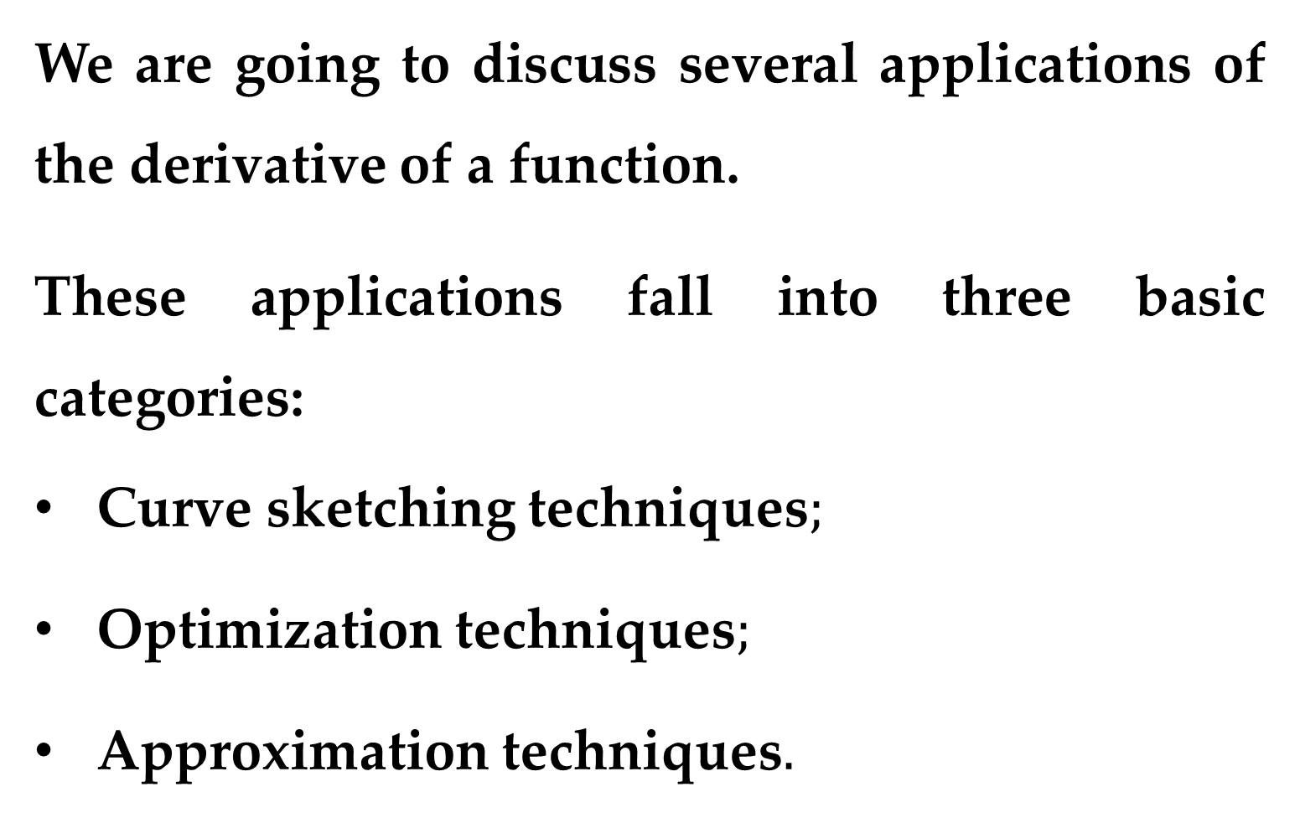
We are going to discuss several applications of the derivative of a function.
These applications fall into three basic categories:
Curve sketching techniques$;$
Optimization techniques$;$
Approximation techniques$.$

Slide 4
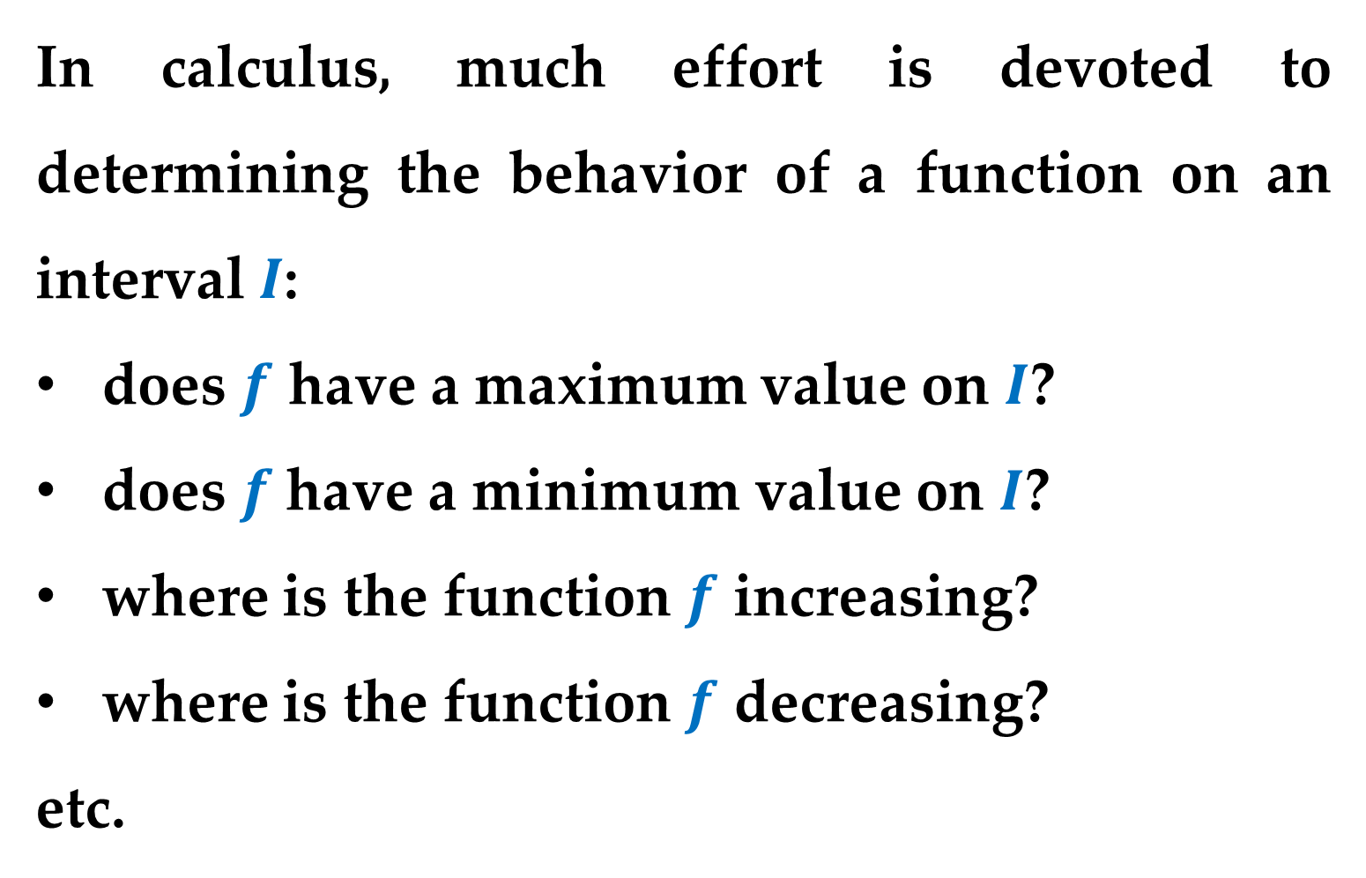
$Extrema on an Interval$
In calculus, much effort is devoted to determining the behavior of a function on an interval $I$:
does $f$ have a maximum value on $I$?
does $f$have a minimum value on $I$?
where is the function $f$ increasing?
where is the function $f$ decreasing?
etc.

Slide 5
In this and subsequent lectures you will learn how derivatives can be used to answer these questions.
You will also see why these questions are important in real-life applications of calculus.

Slide 6
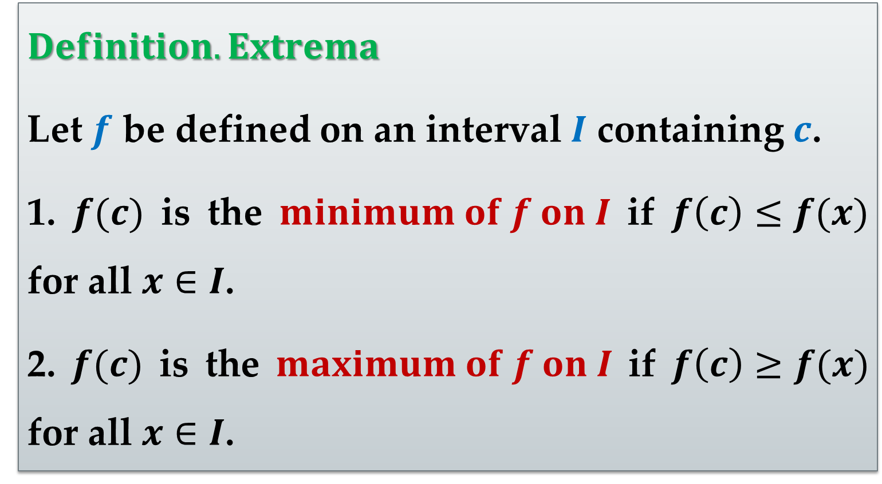
$Definition. Extrema$
Let $f$ be defined on an interval $I$ containing $c$.
1. $f(c)$ is the $minimum of f on I$ if $f\left(c\right)≤f(x)$ for all $x∈I$.
2. $f(c)$ is the $maximum of f on I$ if $f\left(c\right)≥f(x)$ for all $x∈I$.

Slide 7
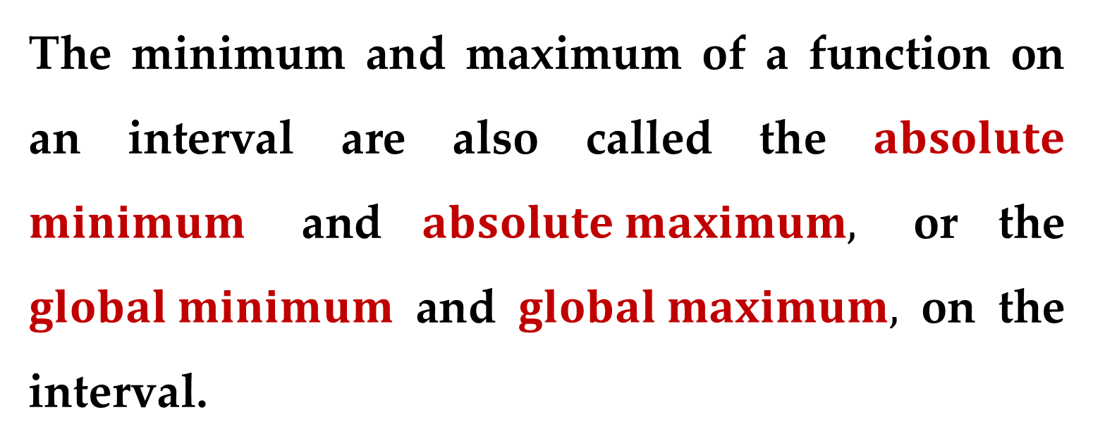
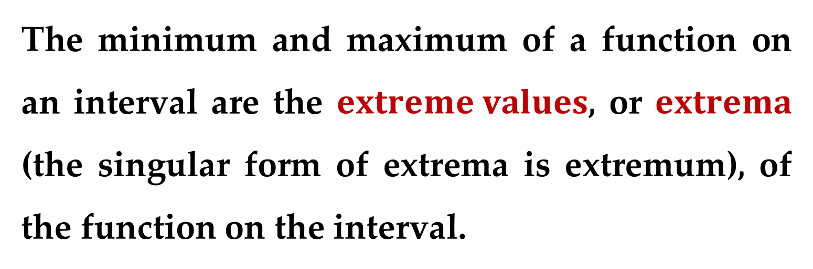
The minimum and maximum of a function on an interval are the $extreme values$, or $extrema$ (the singular form of extrema is extremum), of the function on the interval.
The minimum and maximum of a function on an interval are also called the $absolute$ $minimum$ and $absolute maximum,$ or the $global minimum$ and $global maximum,$ on the interval.

Slide 8
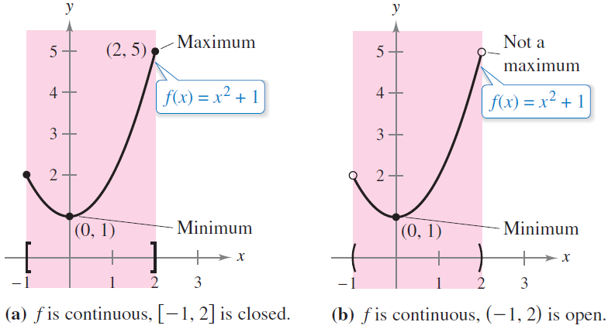
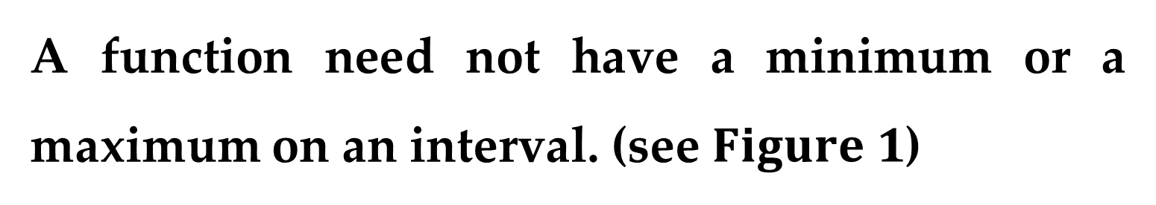
A function need not have a minimum or a maximum on an interval. (see $Figure 1$)

Slide 9
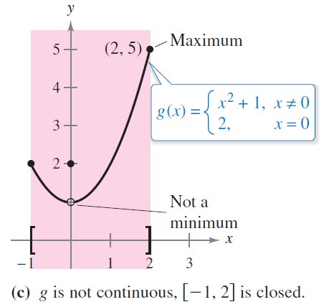
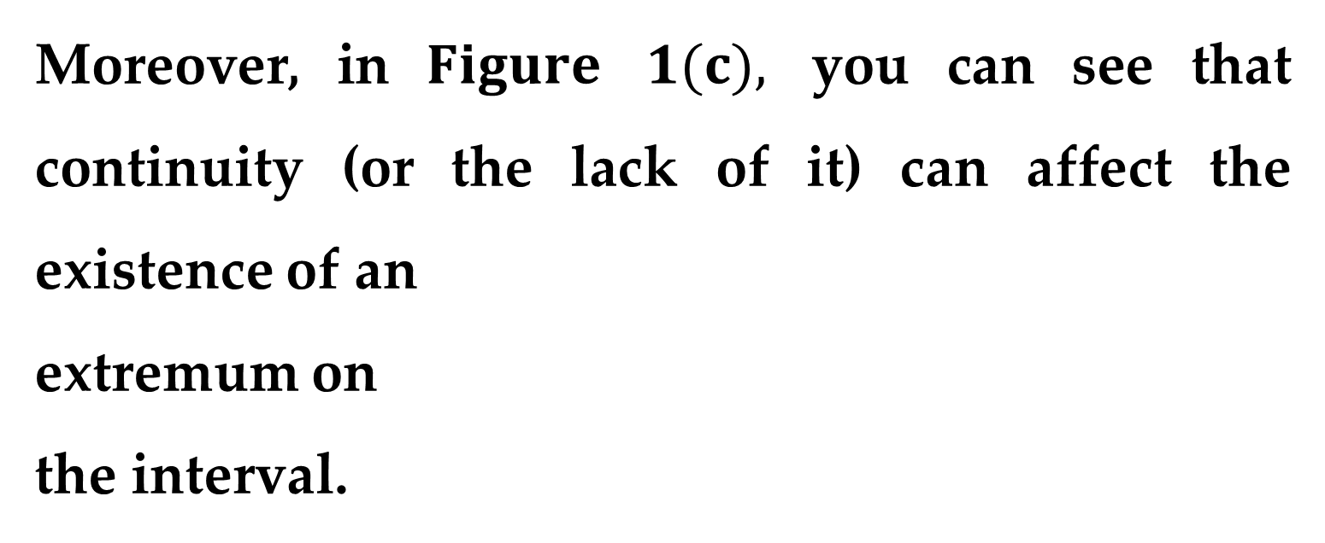
Moreover, in $Figure$ $1(c),$ you can see that continuity (or the lack of it) can affect the existence of an
extremum on
the interval.

Slide 10
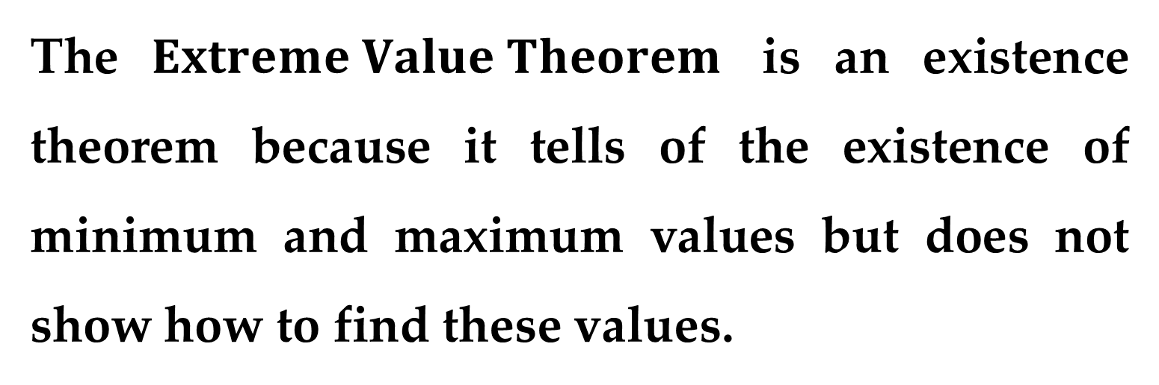
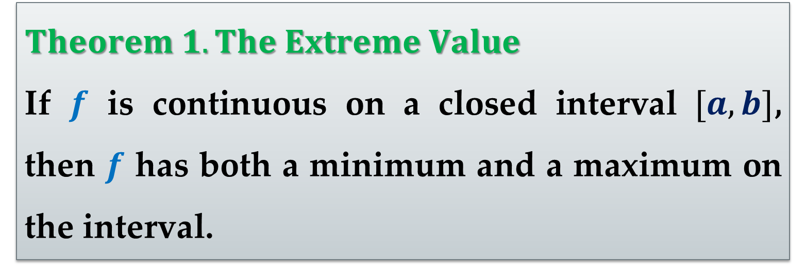
$Theorem 1. The Extreme Value$
If $f$ is continuous on a closed interval $[a,b]$, then $f$ has both a minimum and a maximum on the interval.
The $Extreme Value Theorem$ is an existence theorem because it tells of the existence of minimum and maximum values but does not show how to find these values.

Slide 11
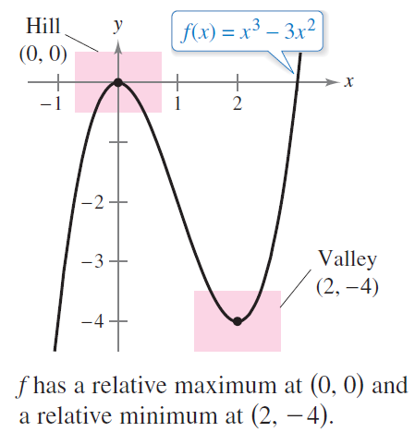
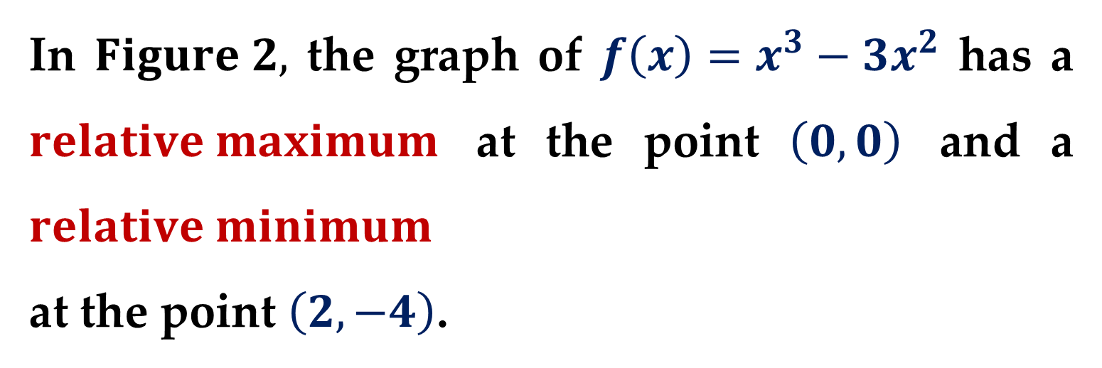
$Relative Extrema and Critical Numbers$
In $Figure 2,$ the graph of $f\left(x\right)=x^{3}−3x^{2}$ has a $relative maximum$ at the point $\left(0,0\right)$ and a $relative minimum$
at the point $\left(2,−4\right)$.

Slide 12
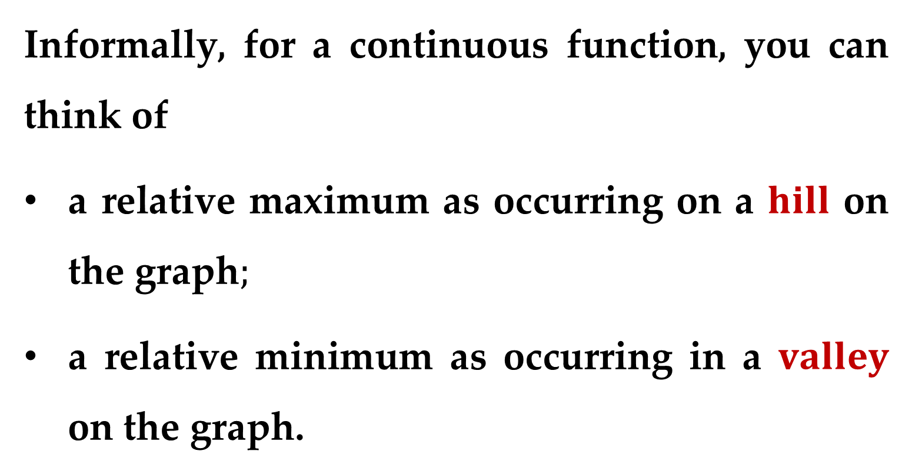
Informally, for a continuous function, you can think of
a relative maximum as occurring on a $hill$ on the graph$;$
a relative minimum as occurring in a $valley$ on the graph.

Slide 13
Such a hill and valley can occur in two ways:
If the hill (or valley) is smooth and rounded, the graph has a horizontal tangent line at the high point (or low point).
If the hill (or valley) is sharp and peaked, the graph represents a function that is not differentiable at the high point (or low point).

Slide 14
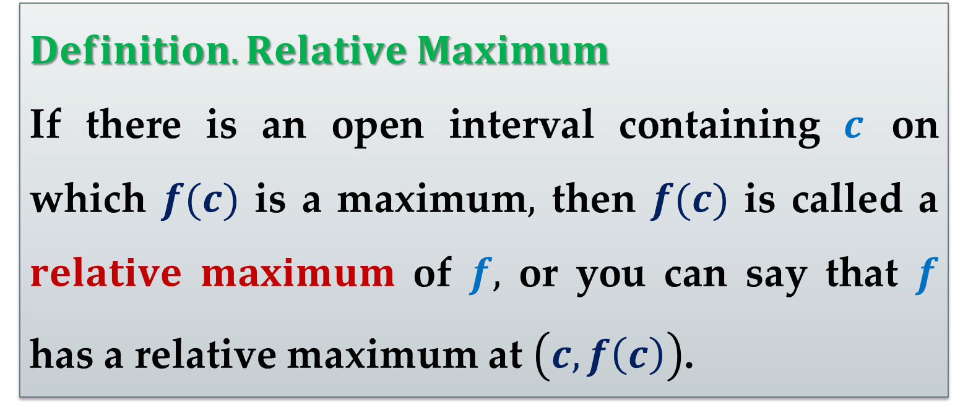
$Definition. Relative Maximum$
If there is an open interval containing $c$ on which $f(c)$ is a maximum$,$ then $f(c)$ is called a $relative maximum$ of $f,$ or you can say that $f$ has a relative maximum at $\left(c,f\left(c\right)\right)$.

Slide 15
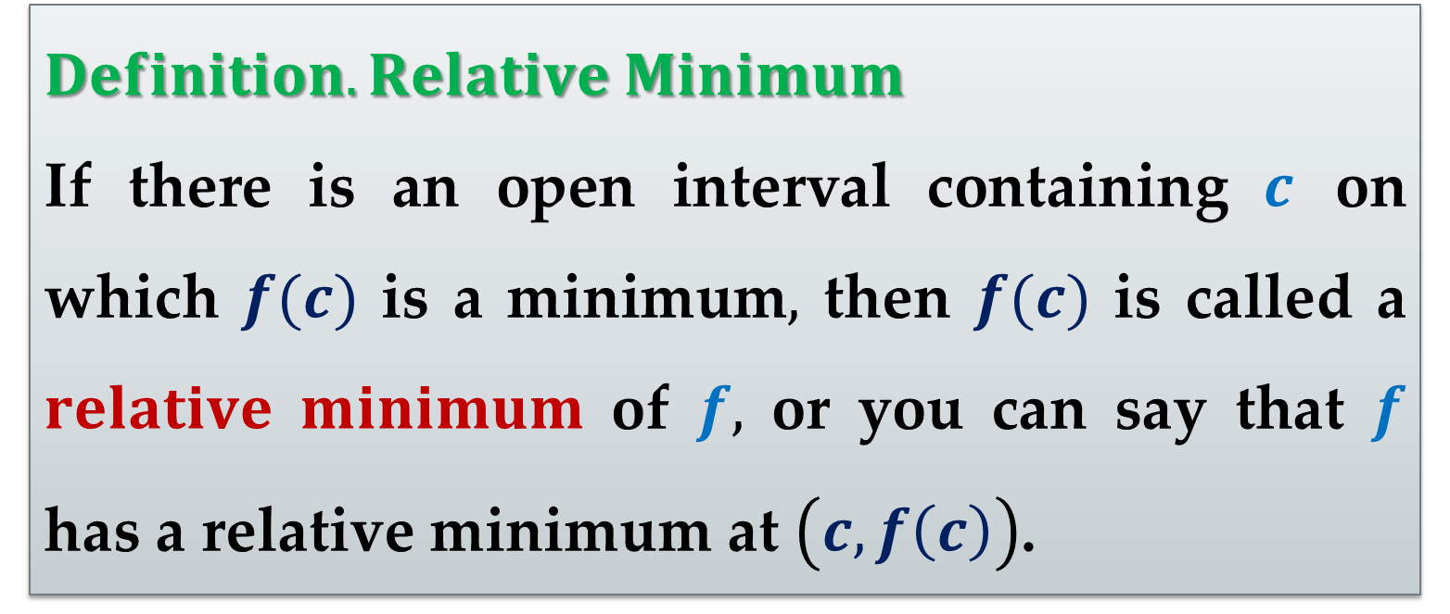
$Definition. Relative Minimum$
If there is an open interval containing $c$ on which $f(c)$ is a minimum$,$ then $f(c)$ is called a $relative minimum$ of $f,$ or you can say that $f$ has a relative minimum at $\left(c,f\left(c\right)\right)$.

Slide 16
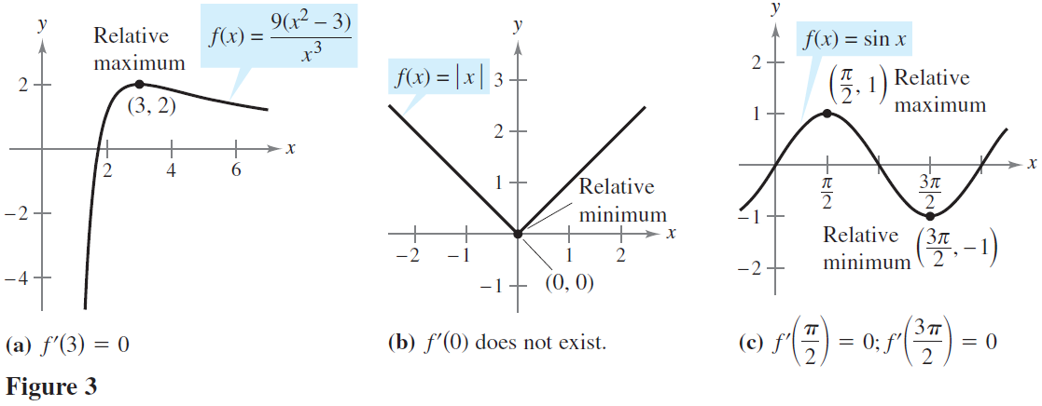
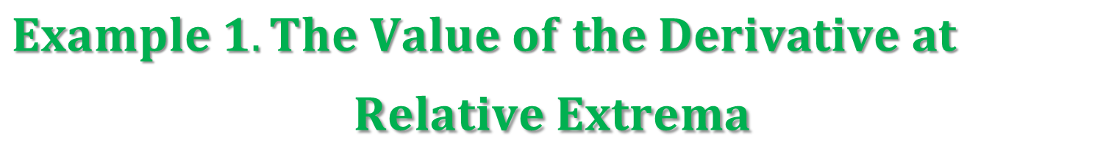
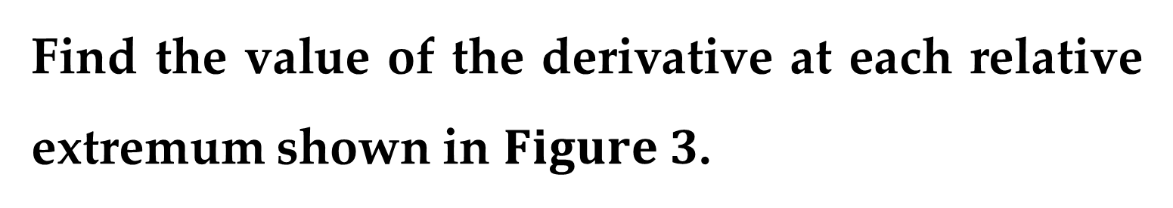
$Example 1. The Value of the Derivative at$
$$Relative Extrema$$
Find the value of the derivative at each relative extremum shown in $Figure 3$.

Slide 17
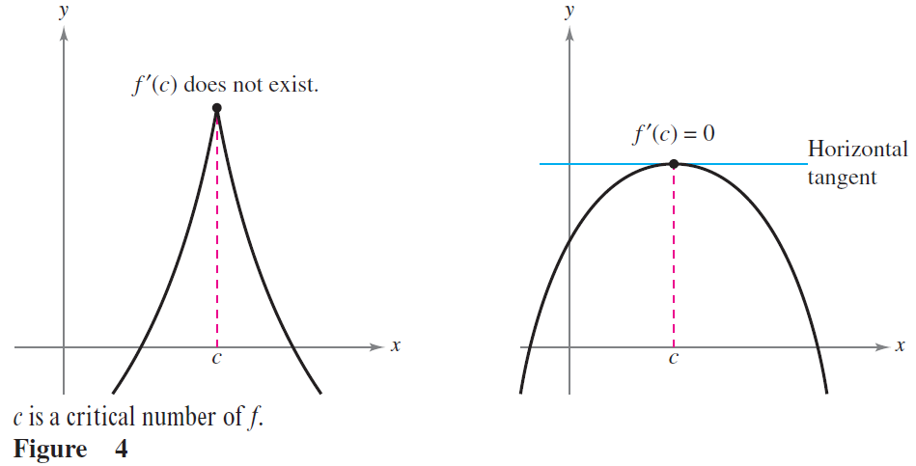
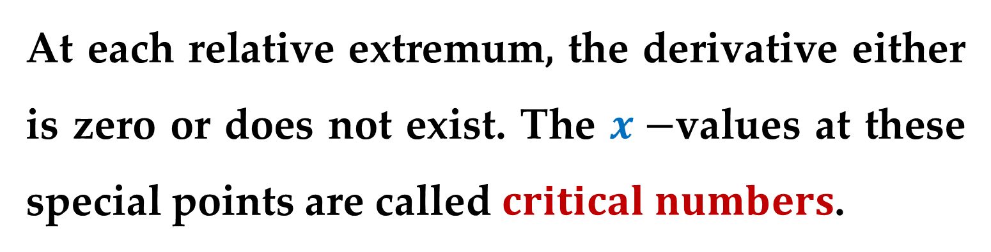
At each relative extremum, the derivative either is zero or does not exist. The $x−$values at these special points are called $critical numbers$.

Slide 18
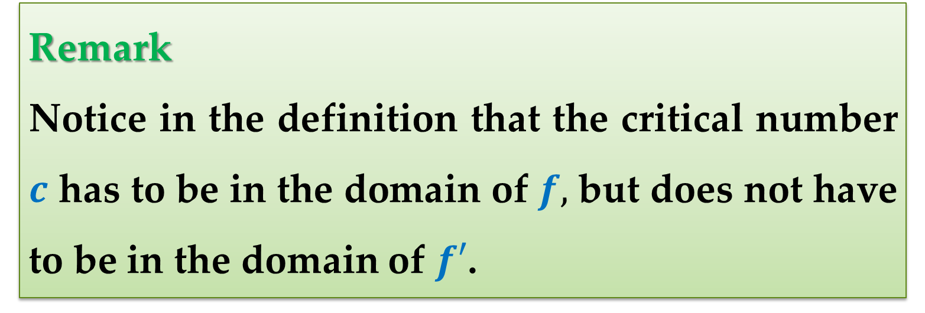
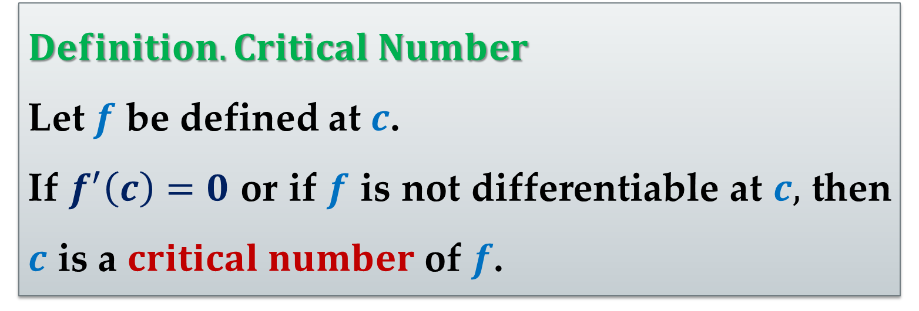
$Definition. Critical Number$
Let $f$ be defined at $c$.
If $f^{′}\left(c\right)=0$ or if $f$ is not differentiable at $c,$ then $c$ is a $critical number$ of $f$.
Remark
Notice in the definition that the critical number $c$ has to be in the domain of $f,$ but does not have to be in the domain of $f′$.

Slide 19
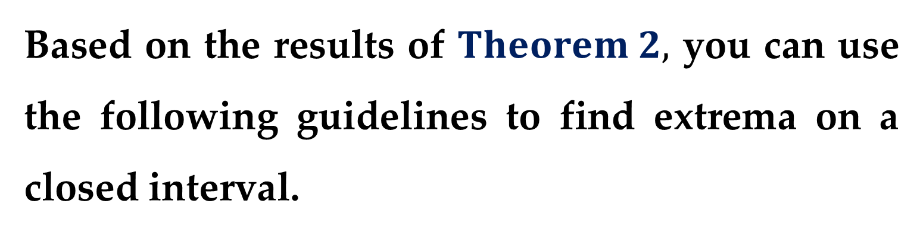
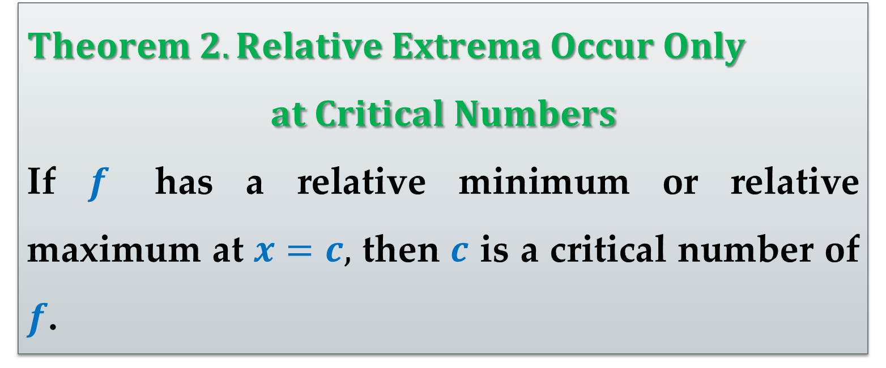
$Theorem 2. Relative Extrema Occur Only$
$$at Critical Numbers$$
If $f$ has a relative minimum or relative maximum at $x=c,$ then $c$ is a critical number of $f$.
Based on the results of $Theorem 2,$ you can use the following guidelines to find extrema on a closed interval.

Slide 20
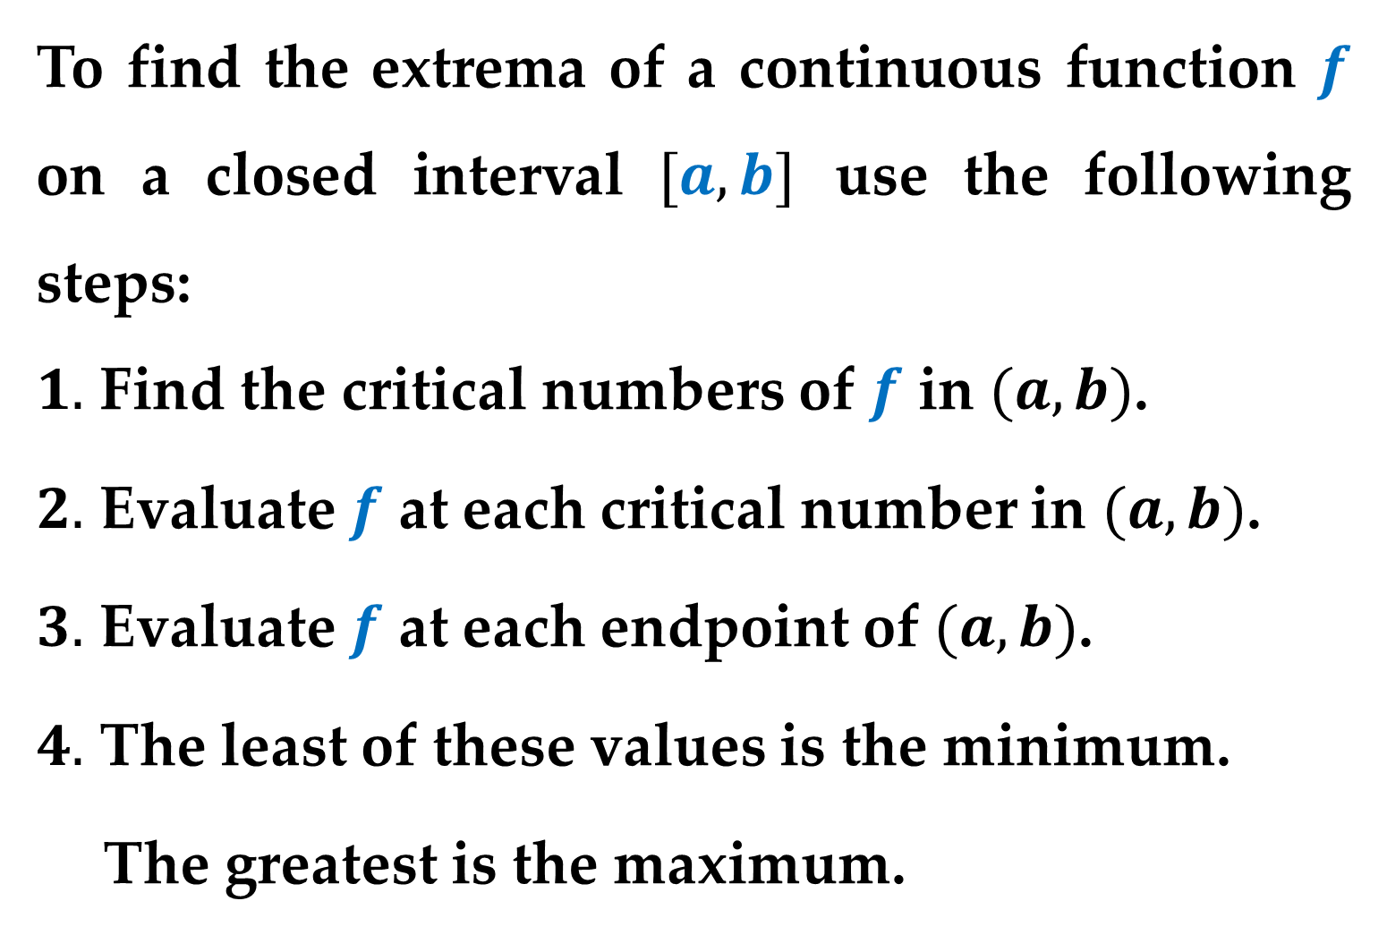
$$Guidelines for Finding Extrema$$
To find the extrema of a continuous function $f$ on a closed interval $[a,b]$ use the following steps:
$1.$ Find the critical numbers of $f$ in $(a,b)$.
$2.$ Evaluate $f$ at each critical number in $(a,b)$.
$3.$ Evaluate $f$ at each endpoint of $(a,b)$.
$4.$ The least of these values is the minimum.
The greatest is the maximum.

Slide 21
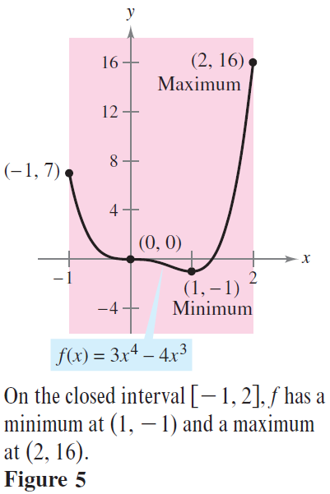
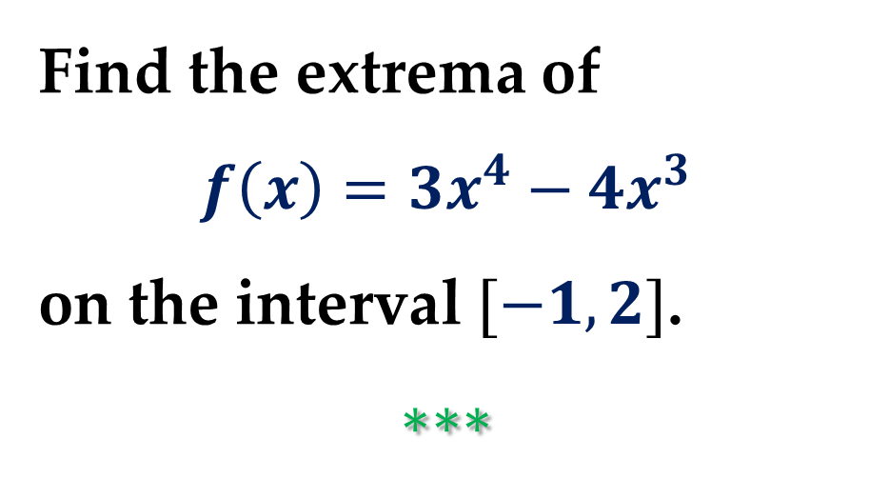
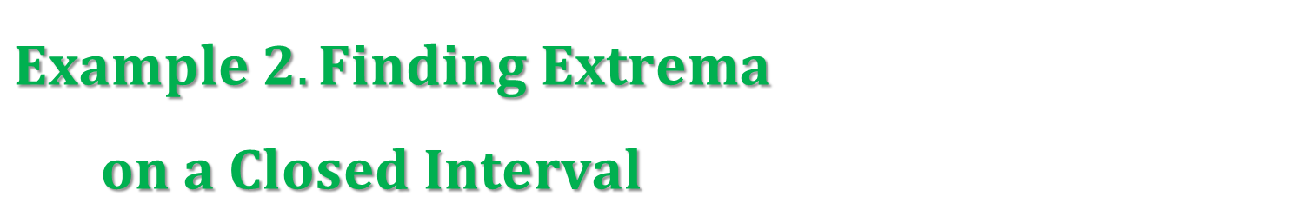
$Finding Extrema on a Closed Interval$
$Example 2. Finding Extrema$
$on a Closed Interval$
Find the extrema of
$$f\left(x\right)=3x^{4}−4x^{3}$$
on the interval $[−1,2]$.
$$∗∗∗$$

Slide 22
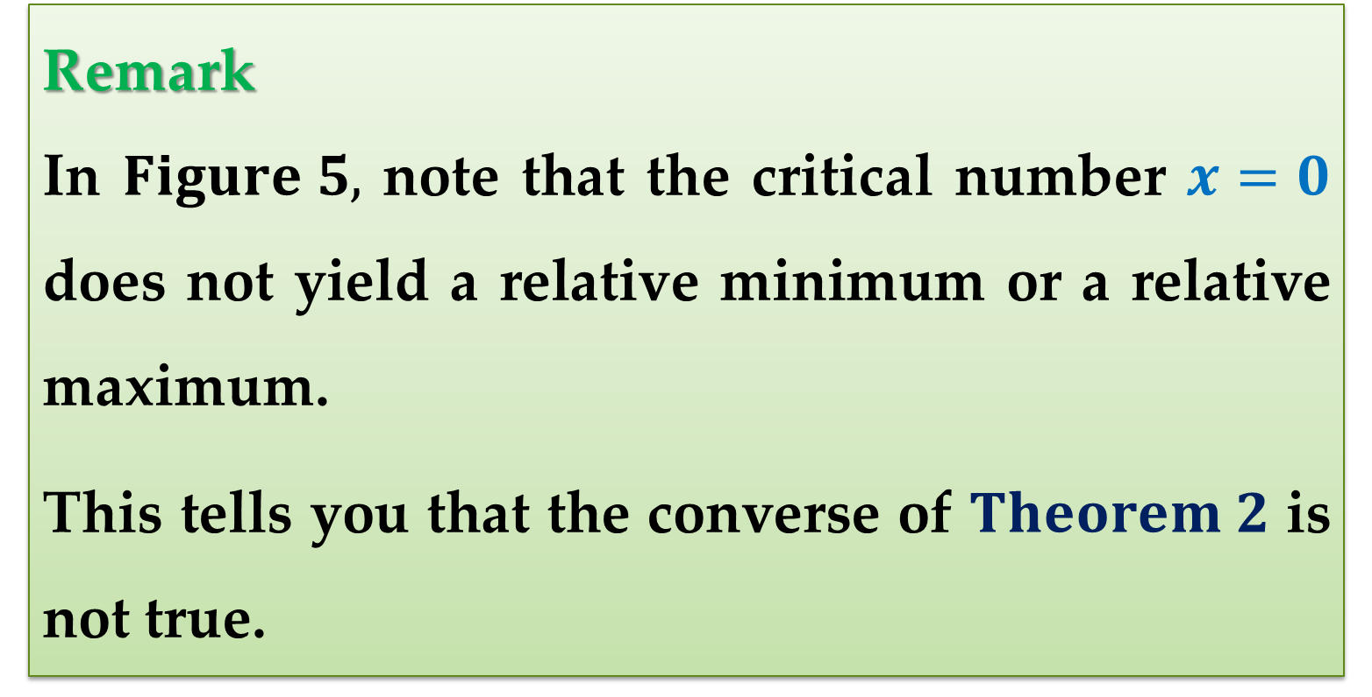
Remark
In $Figure 5,$ note that the critical number $x=0$ does not yield a relative minimum or a relative maximum.
This tells you that the converse of $Theorem 2$ is not true.

Slide 23
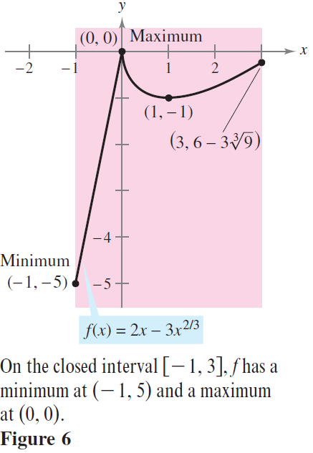

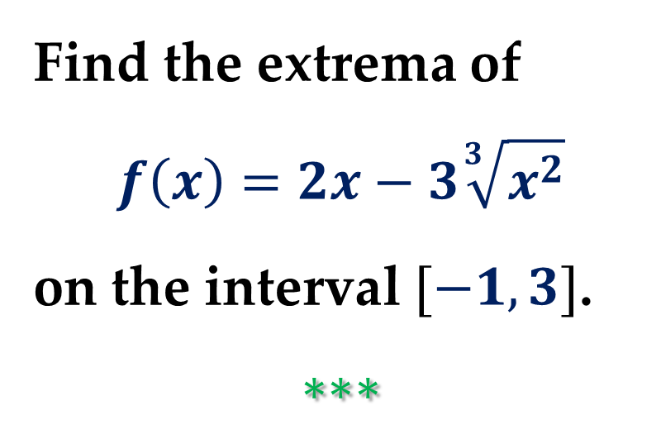
$Example 3. Finding Extrema on a$
$Closed Interval$
Find the extrema of
$$f\left(x\right)=2x−3\sqrt[3]{x^{2}}$$
on the interval $[−1,3]$.
$$∗∗∗$$

Slide 24
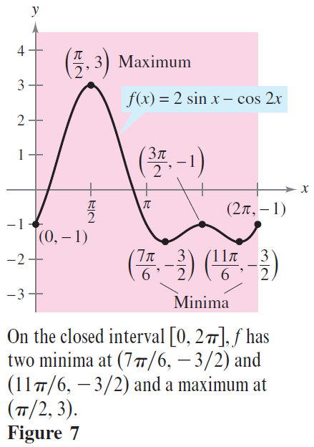

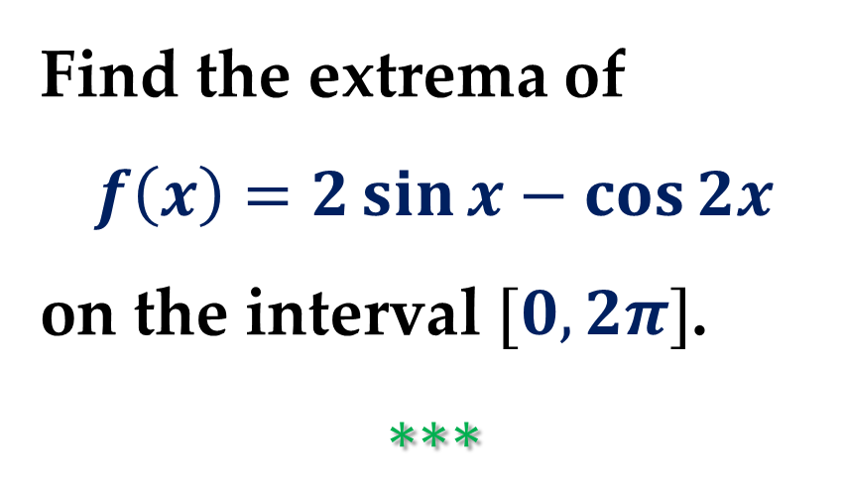
$Example 4. Finding Extrema on a$
$Closed Interval$
Find the extrema of
$$f\left(x\right)=2\sin{x}−\cos{2x}$$
on the interval $[0,2π]$.
$$∗∗∗$$

Slide 25
Thank you for attention

